Slide 1
INTERSTITIAL LUNG DISEASE
by
Dr. Arvind Mishra M.D.
Professor
Department of Internal Medicine

Slide 2
INTERSTITIAL LUNG DISEASE
Group of disorders having generalized involvement of lung interstitium.
200 different diseases of multiple etiologies
These disorders are lebelled as ILD because of the common clinical, radiological and histological manifestations

Slide 3
IMPORTANT CAUSES OF ILD
Primary or idiopathic
Idiopathic Pulmonary Fibrosis
Nonspecific interstitial pneumonia (NSIP)
Organising pneumonia (OP)
Respiratory bronchiolitis (RB)
Diffuse alveolar damage (DAD)
Desquamative interstitial pneumonia (DIP)
Lymphocytic interstitial pneumonia (LIP)

Slide 4
Secondary Causes
1.Infectious
Tuberculosis
Bacterial
Fungal
Parasitic
Viral
2. Noninfectious
Hypersensitivity pneumonitis
Pneumoconiosis
Drug induced
Radiation induced
Malignancies

Slide 5
Association with diseases of unknown aetiology
Sarcoidosis
Connective tissue disorders
Systemic sclerosis
Rheumatoid arthritis
Dermatomyositis,Polymyositis
SLE
Chronic eosinophilic pneumonia

Slide 6
Idiopathic Pulmonary Fibrosis (IPF/UIP)
Defined as progressive fibrosing interstitial pneumonia of unknown cause. Histo/radio like Usual Interstitial pneumonia
Histology suggestive of repeated focal damage to alveolar epithelium.
Usually present in older adult, uncommon before 50 yrs.
Presents with progressive breathlessness and a nonproductive cough.
Clinical findings-clubbing and fine late inspiratory crepts.

Slide 7
Non specific interstitial pneumonia
Clinical picture same as IPF although pts. tend to be women , younger in age who never smoked.
Often associated with connective tissue disease, hypersensitivity pneumonitis and HIV infection.
Lung biopsy may be required for Dx.
Prognosis better than IPF.

Slide 8
Respiratory Bronchiolitis
More common in men and smokers.
Usually presents at 40-60yrs. of age.
Smoking cessation leads to improvement.
Natural history unclear

Slide 9
Organising Pneumonia(BOOP-broncholitis obliterans organising pneumonia)
Clinically and radiologically pneumonia.
Raised ESR common.
Finger clubbing absent.
Biopsy- florid proliferation of immature collagen and fibrous tissue.
Response to corticosteroids- Excellent.

Slide 10
Acute Interstitial Pneumonia (DAD)
Often preceded by viral URTI
Severe exertional dyspnoea.
Widespread pneumonic consolidation and diffuse alveolar damage on biopsy.
Prognosis poor.

Slide 11
DESQUAMATIVE INTERSTITIAL PNEUMONIA
Exclusively in cigarette smokers
Histological hallmark- excess accumulationof macrophages in intraalveolar spaces with minimal interstitial fibrosis
In 4th to 5th decade
Better prognosis in response to smoking cessation

Slide 12
Lymphocytic Interstitial Pneumonia(LIP)
More common in women.
Slow onset over years.
Associates with connective tissue disease and HIV infection.
Corticosteroids may be helpful.

Slide 13
Commonly used drugs leading to ILD
Non steroidal anti-inflammatory drugs
Nitrofurantoin
Phenytoin sodium
Carbamazepine
Antiarrhythmic drugs
Hydralazine
D-Penicillamine
Amiodarone
Cyclophosphamide
Methotrexate

Slide 14
PATHOLOGY
Pulmonary interstitium is the anatomical space between the alveolar and the capillary basement membranes.
Contains mesenchymal and connective tissue cells and extra cellular matrix composed of collagen, elastin and proteoglycans.
Involvement of interstitium+adjoining alveolar epithelial+Capillary endothelial cells.
Disease encroaches alveolar spaces involving acini,terminal bronchioles and overlying pleura.

Slide 15
Features common to ILD’s
1.Clinical presentation-
Cough-dry, persistent, distressing
Breathlessness-usually slowly progressive, insidious onset, acute in some cases.
2. Examination findings-
Crackles-typically bilateral and basal
Clubbing-common in idiopathic pulmonary fibrosis, also seen in other conditions eg.Asbestosis
Central cyanosis
Right heart failure

Slide 16
Radiology
Chest radiograph-
Interstitial infiltrates seen as discrete,linear,nodular or reticulonodular shadows(less than 2mm)- diffuse distribution in both the lungs.
These may coalesce forming large nodules.
In advanced stage-fibrosis is extensive, lungs are shrunken and reduced in volume.
A normal chest x-ray-does’nt exclude ILD

Slide 17
PATTERNS ON CHEST X-RAY LINEAR

Slide 18
reticular

Slide 19
NODULAR

Slide 20
RETICULONODULAR

Slide 21
HRCT
Ground glass appearance
Reticulonodular shadowing
Honey-comb lung-small,uniform sized,cystic spaces representing patent bronchioles
Traction bronchiectasis
Provides quantitative assesment of pulmanary fibrosis

Slide 22
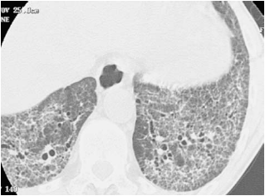
RETICULAR INFILTRATES
Schwarz, ILD, 2003, HP

Slide 23
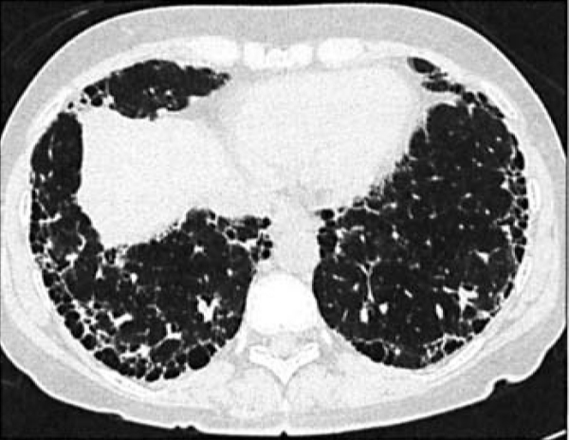
HONEYCOMB LUNG

Slide 24
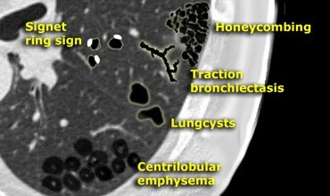
Hrct of ipf
On HRCT, a confident diagnosis of IPF is based on the presence of bilateral, predominantly subpleural, and basal reticular opacities with associated traction bronchiectasis and honeycombing in the absence of small nodules or extensive ground-glass opacity .this is known as “confident” pattern of IPFon HRCT.

Slide 25
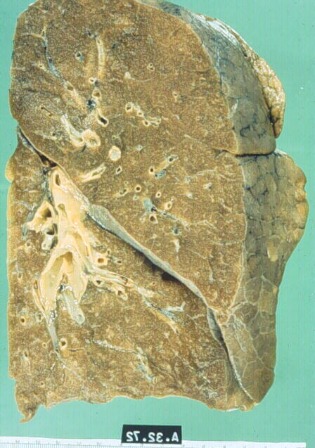
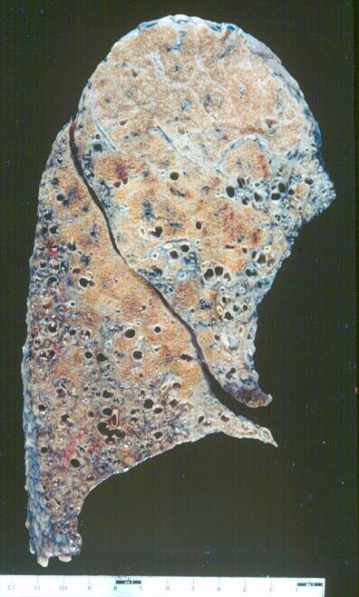
IPF
Normal Lung- cut surface and pleura smooth and homogenous
IPF- cut surface demonstrates patchy involvement of lung with fibrous scarring
around dilated airspaces forming a honey comb pattern

Slide 26
Pulmonary Function Tests
Restrictive defect on spirometery
Tidal volumes are small
Vital capacity/Total lung capacity-reduced
Reduced diffusing capacity/ Arterial hypoxemia- observed in late stages

Slide 27
BRONCHOSCOPY Bronchoalveolar lavage:
Differential cell counts may point to sarcoid, drug induced pneumonitis, pulmonary eosinophilia, hypersensitivity pneumonitis and organising pneumonia. Useful to exclude inf.
Transbronchial biopsy-useful in Sarcoid
Video-assisted thoracoscopic lung biopsy-
Allows pathological classification
Standard for Dx. Of ILD
Should be done under 60 yrs of age

Slide 28
Others
ESR
LFT / KFT
ANA
Urinary calcium excretion- Sarcoidosis
Increased SACE (serum angiotensin converting enzyme) values- Sarcoidosis
Liver biopsy- may be useful in Sarcoidosis

Slide 29
Management
Mx. Of secondary ILD depends upon the cause
Mx. Of idiopathic ILD-not satisfactory
Mainstay of treatment-anti-inflammatory therapy largely with corticosteroids
Criteria to start treatment-
Presence of severe/worsening symptoms
Younger age of onset
Shorter duration of illness

Slide 30
Corticosteroids
Prednisolone given in a dose of 1 – 1.5 mg for 6 – 12 weeks followed by maintenance dose of 15 – 20mg daily for 1 – 2 years or longer
I.V. Cyclophosphamide given as intermittent pulse therapy ( 1 – 1.3 gm / month) along with pred. therapy provides symptomatic relief.
Combination of low dose pred. with Azathioprine – maintenance Tt. For 2-3 yrs.

Slide 31
RECENT ADVANCEMENTS
Colchicine(0.6-1.2mg) for 6-12 months-safe
D-penicillamine,N-acetyl cysteine and Pirfenidone- variable results
Lung transplant-advanced end stage disease. Single lung transplantation suffice in most patients
Five-year survival is reported in upto 40% of patients

Slide 32
Prognosis
Course of ILD is progressive and fatal in most patients of primary IPF
Median survival of IPF is about 4 years
No improvement in survival observed for last 40-50yrs.
ILD’s secondary to systemic diseases or other causes follow the course of the underlying disease

Slide 33
MCQs

Slide 34
1)PFT in ILDs will show
a)Reduction in TLC
b)Increase in functional residual capacity
c)Increase residual volume
d)All of the above

Slide 35
2)Which of the following is false about DIP
a)Found exclusively in cigarette smokers
b)Macrophages in intraalveolar spaces
c)Minimal interstitial fibrosis
d)Worse prognosis than IPF

Slide 36
3)Hamman rich syndrome is name given to
a)Acute interstitial pneumonia
b)Hypersensitivity pneumonitis
c)DIP
d)Respiratory bronchiolitis

Slide 37
4)Most common form of pulmonary involvement in connective tissue disorders
a)Cryptogenic organizing pneumonia
b)Desquamative interstitial pneumonia
c)Respiratory bronchiolitis
d)Nonspecific interstitial pneumonia

Slide 38
5)Which of the following is known as BOOP
a)Cryptogenic organizing pneumonia
b)Desquamative interstitial pneumonia
c)Respiratory bronchiolitis
d)Lymphocytic interstitial pneumonia

Slide 39
6)Variety of ILD associated with smoking is
a)Acute interstitial pneumonia
b)Respiratory bronchiolitis
c)Idiopathic pulmonary fibrosis
d)Non specific interstitial pneumonia

